Slide 1

Memento Design Pattern
By: Terry McGlaston Jr & Sean Dsouza
Notes:
Image source - https://cdn-icons-png.flaticon.com/128/2810/2810399.png
Terry

Slide 2
Memento Pattern Introduction:
The Pattern’s Purpose:
The common problem that it solves is that of creating save states for software or programs.
Why “Memento”:
In order to create multiple saves of a the program, it creates “memento objects” to save the internal state of the project.
Notes:
Terry
Research sources (used in slides 2-4):
https://www.geeksforgeeks.org/memento-design-pattern/
https://refactoring.guru/design-patterns/memento
https://sourcemaking.com/design_patterns#:~:text=In%20software%20engineering%2C%20a%20design,used%20in%20many%20different%20situations.
Erich Gamma, Richard Helm, Ralph Johnson, John Vlissides (1994). Design Patterns: Elements of Reusable Object-Oriented Software (book)

Slide 3
Parts of the Pattern
Memento Class: The object that will keep the state of the originator.
State Class: The current settings of the object (exists in both originator and memento classes).
Caretaker Class: The class that will preform tasks on the originator.
Originator Class: The object for which the state is saved.

Slide 4
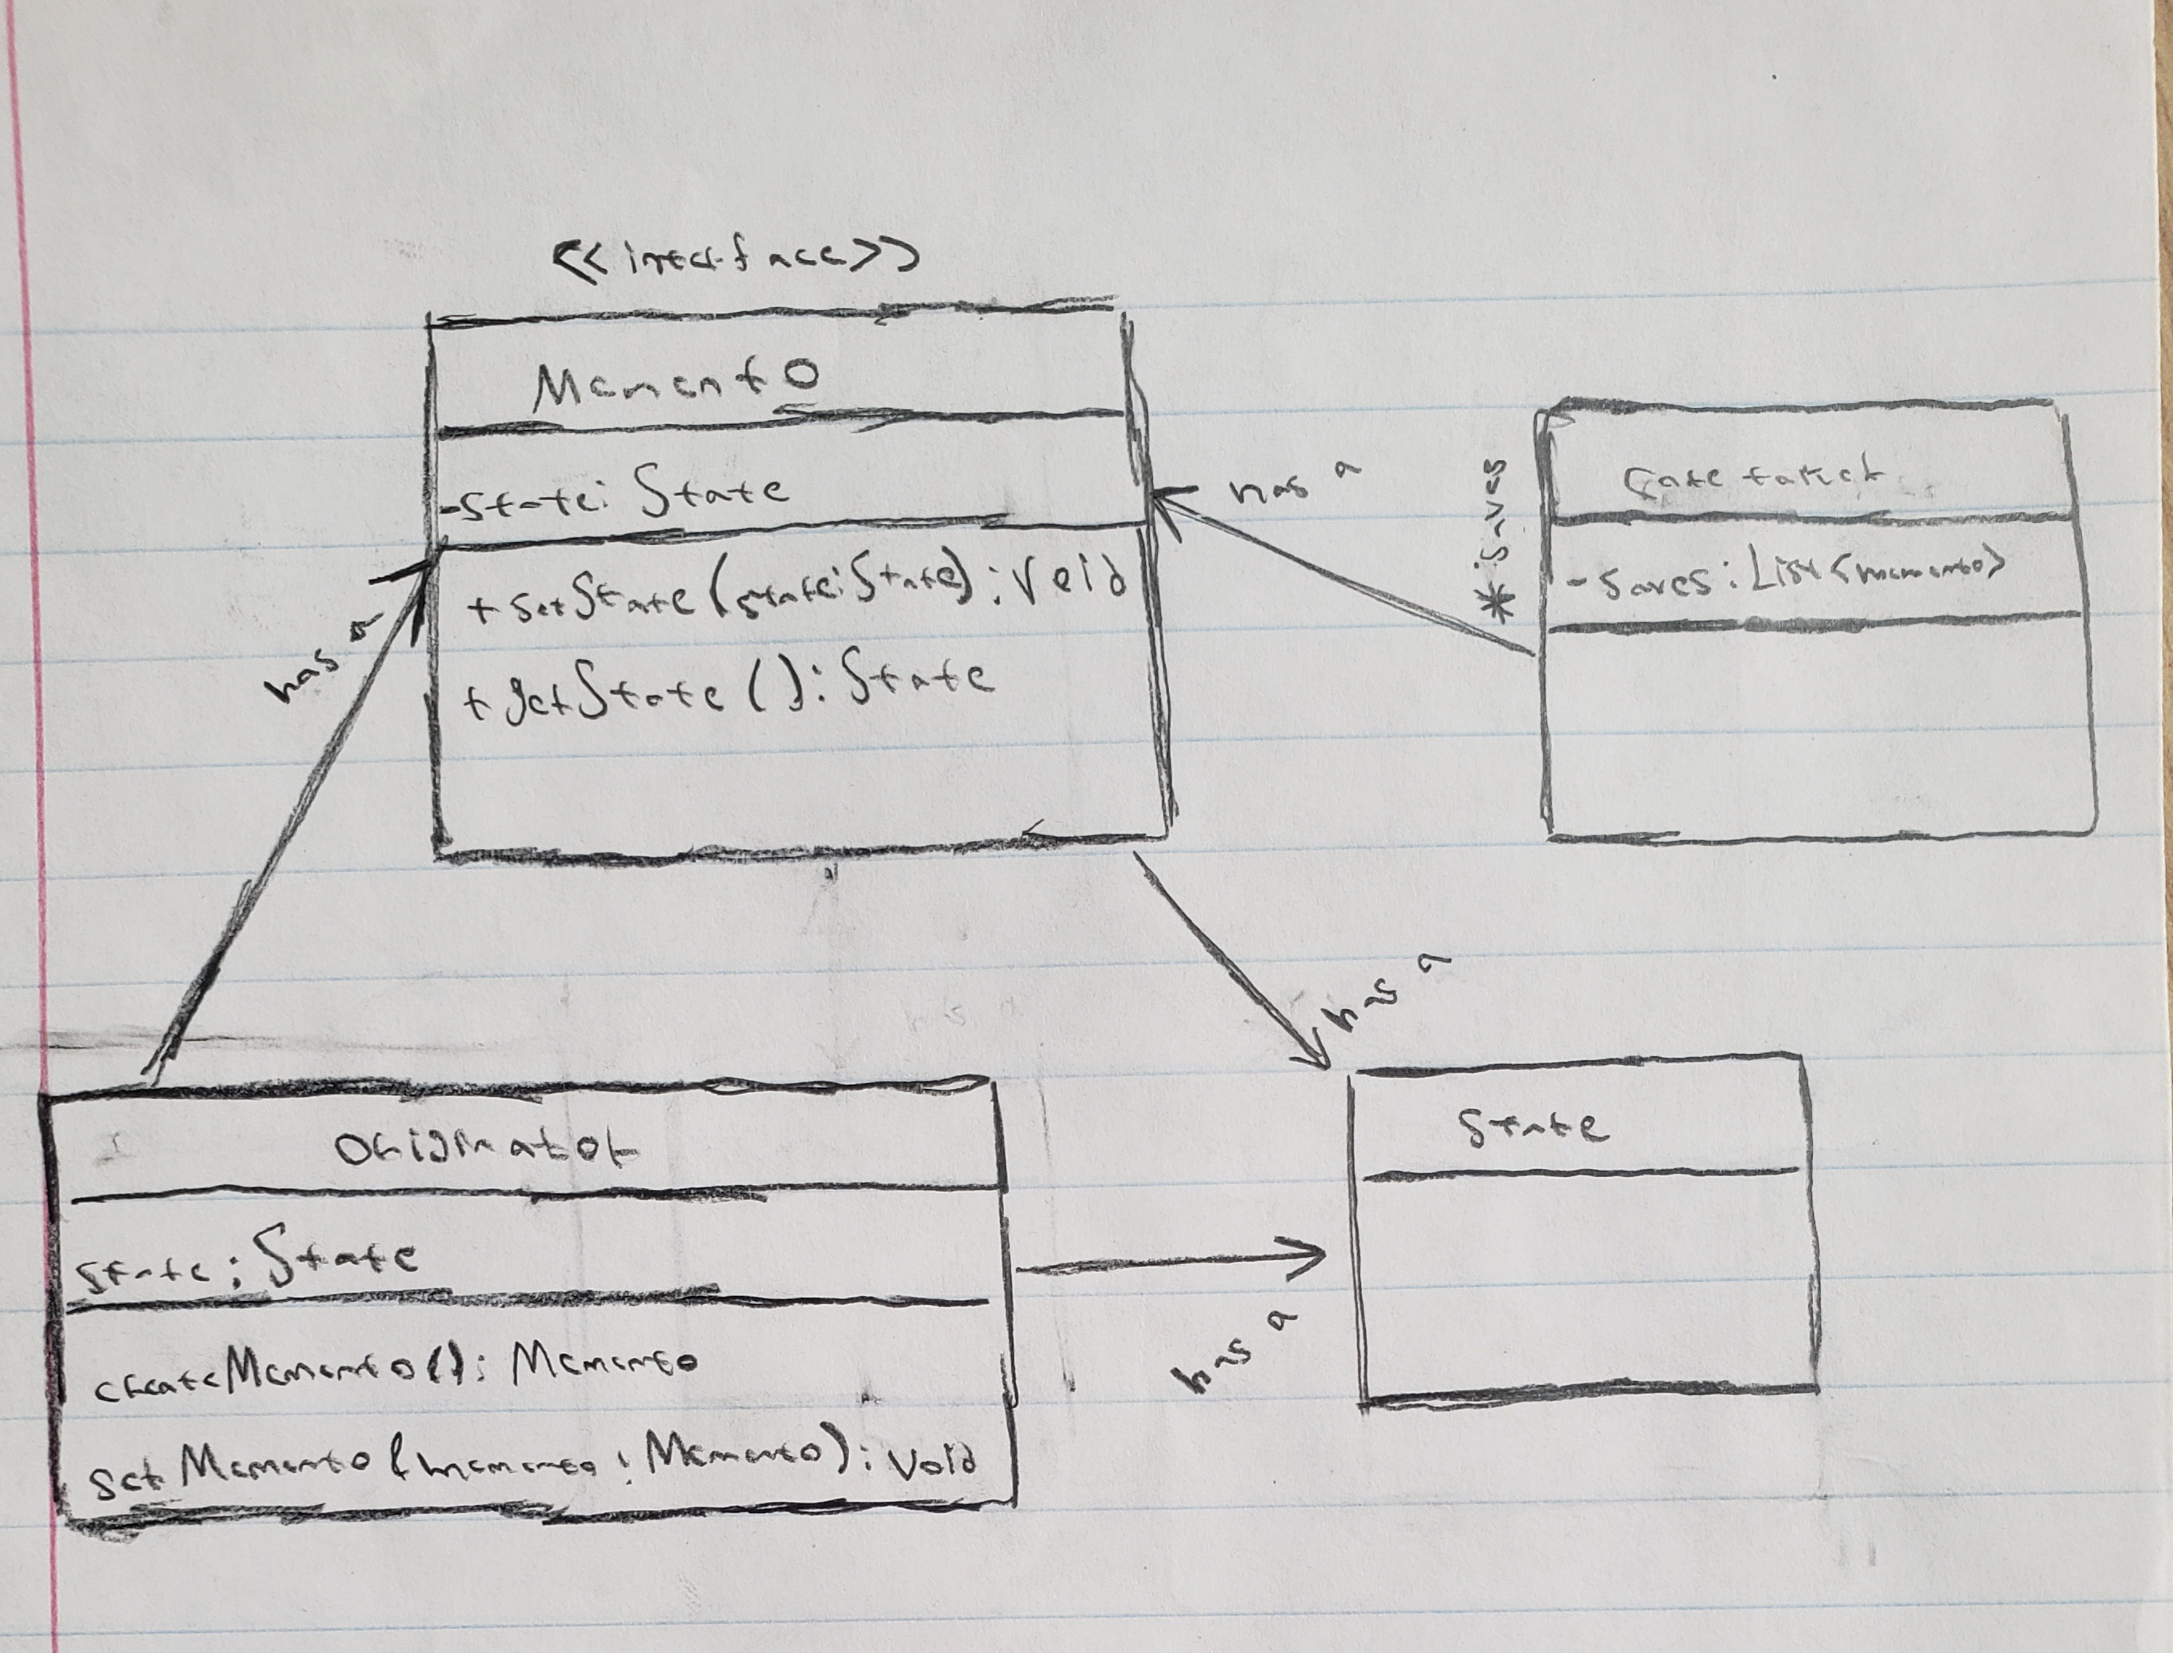
Mechanics of the Memento Pattern:
How does this pattern work?
Main class is the caretaker (handles “save states”)
Caretaker class the methods of the other classes.
Can have additional classes to modify the memento objects.
Notes:
Terry

Slide 5
Other uses of the Pattern (real life examples):
Problems they address and solve:
Can be used for “roll backs” to a previous state:
An example of this would be “roll back” connection for fighting games.
Another example would be quick saving and loading in a game.
It can be used to save the internal state of something externally:
Like having a repo of updates for a program.
Or how you can create multiple saves of a game or edits of a picture.
Notes:
Terry

Slide 6
Why use the pattern over a list of states?
You don’t have direct access to the states in a simple list (pattern allows for access through the caretaker class).

Slide 7
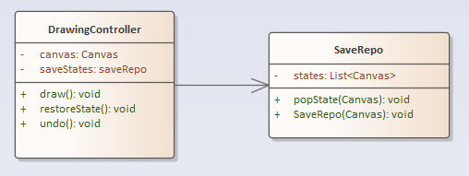
UML of Demo:
Notes:
Sean

Slide 8
Demonstration
Our implementation of the pattern.
Notes:
Sean

Slide 9
Advantages & disadvantages of implementation:
Advantages:
Allows for the saving of states (to undo, redo actions)
With lists, it can theoretically go infinitely
Disadvantages:
The further back you need to undo & redo, the more storage required
If storage is cleared/lost for any reason then you can no longer restore
Notes:
Sean

Slide 10
Memento pattern conclusion (and summary):
You can use the memento pattern to save and restore various states of an object
The basis of rolling back states
Notes:
Sean

Slide 11
Appendix
Author:
The Memento Pattern was created by Noah Thompson, David Espiritu, and Dr. Drew Clinkenbeard for early HP products. (source below) – Move to appendix
Other things of note:
Having the memento patterns allows for branching paths via save states. (move to appendix)

